Slide 1
Basic linux utilities and system calls
File Handling
Processing
Disk
Networking
Filters
Backup
system calls - open,read,write,close

Slide 2
Linux:
Linux is one of the popular version of unix os.
it is open source
Linux is designed considering unix compatability
functionality is similar to unix
Flavors of Linux:
ubuntu
debian
fedora
centos/red hat
Flavors of unix:
linux
solaris,HP-UX,IBM-AIX

Slide 3
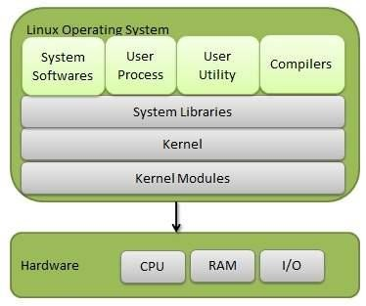
Components of Linux System
Kernel:
Kernel is a core part of the linux
it is a heart of the os
it is a lowest layer of the os
it is directly interact with the h/w
it abstract the low level h/w details to application programs
kernel provides the services to all other parts of the os.
kernel loads first in memory after os has been loaded and resides in memory until os is shutdown.
kernel is an interface b/w sell and h/w.
kernel mainly does low level programming (0’s &1’s)
it doesn’t understand high level language

Slide 4
System Libraries:System libraries are special functions or programs using which application programs and system utilities access the kernel features.
System Utility: System utility programs are responsible to indvidual task.
FEATURES:
Portable: Linux kernel & appplication programs support their installation in any kind of h/w.
Open source: Linux source code is free
Multi user:Multiple users can access system.
Multiprogramming:Multiple applications run at a time
Hierarchical file system: Linux provide standard file structure in which system files/user files are arranged.
Security:linux provide user security using authentication feature like password
shell:shell having the interpreter program using which can execute the commands of os

Slide 5
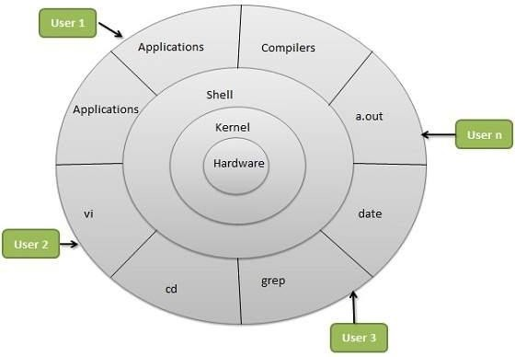
LINUX ARCHITECTURE
HARD WARE: The physical components of computer like cpu,memory,I/O devices.
SHELL:
Shell is called as command level interpreter.
shell is a collection of commands
shell check the syntax of commands. if it correct convert high level code to machine level code
and submit to kernel
it is an interface b/w user
applications and kernel

Slide 6
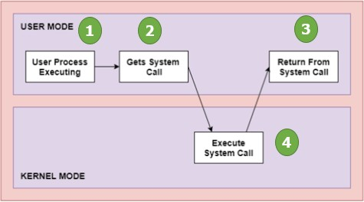
System calls
System call is a mechanism used by application programs to request services from os.
Memory is divided into 2 types
user space: Application programs will get
executed
kernel space:device management,
process management,memory management.
os performs 2 modes of operations
user mode:if the system executes user applications then we say that system is in user mode
kernel mode:if the system executes the system call then the we say that system is in kernel mode(os mode,previlege mode).
in order to maintain the mode the h/w provides the mode bit.
mode bit=1 user mode, mode bit=0 kernel mode.
mode bit:it is used to represents the type of operation performing by the system.

Slide 7
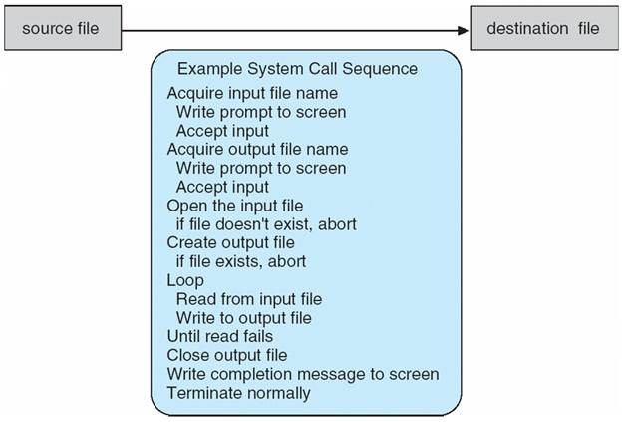
in order to use the services of the os we will use system calls in application programs.
system calls are written at the time of os designed.
system calls are written in high level languages c/c++
system calls can be accessed by programs via API rather than direct system call
API is a collection of library functions.
common API’s win32 for windows, posix API’s for unix/linux
example: read data from i/p file and write into o/p file

Slide 8
A number is associated with each system call
system call interface maintains a table index according to these numbers.
system call interface invokes the system calls in os kernel and returns the system call status.
the caller doesn’t know about how the system call is implemented
caller just need API to understand the result
most details of os interface hidden from programmer by API
SYSTEM CALLS (OPEN,READ,WRITE,CLOSE)
open:opens a file
read:reads from file
write:write to a file
close:close a file

Slide 9
open: syntax int open(const char *patname,int flags);
if the file is ready and file is in same directory where program is present then simply write the file name.
if the file is not ready to create use the below syntax
int creat(const char *pathname,mode_t mode);
if the file is in different directroy will provide the entire path
flags:O_RDONLY,O-WRONLY OR O_RDWR
open system call returns file discriptor.
file discriptor is unique identifier of open file
the basic file discriptors already allocated
standard input--0
standard output-1
standard error--2

Slide 10
read: syntax ssize_t read(int fd,void *buf,size_t count);
write: ssize_T write(int fd, const void *bf,size_t count);
lseek: if we want to read the file from begining
off_t lseek(int fd, off_t offset,whence);
default value of offset is 0
whence having seek-set,seek-cur and seek-end
seek-set--offset is set to offset bytes
seek-cur--offset is set ot current loc+offset bytes
seek-end--offset is set to size of file+offset bytes

Slide 11
TypesofSystem Calls | Windows | Linux
Process Control | CreateProcess()ExitProcess()WaitForSingleObject() | fork()exit()wait()
FileManagement | CreateFile()ReadFile()WriteFile()CloseHandle() | open()read()write()close()
DeviceManagement | SetConsoleMode()ReadConsole()WriteConsole() | ioctl()read()write()
InformationMaintenance | GetCurrentProcessID()SetTimer()Sleep() | getpid()alarm()sleep()
Communication | CreatePipe() CreateFileMapping()MapViewOfFile() | pipe()shmget()mmap( )

